Slide 1
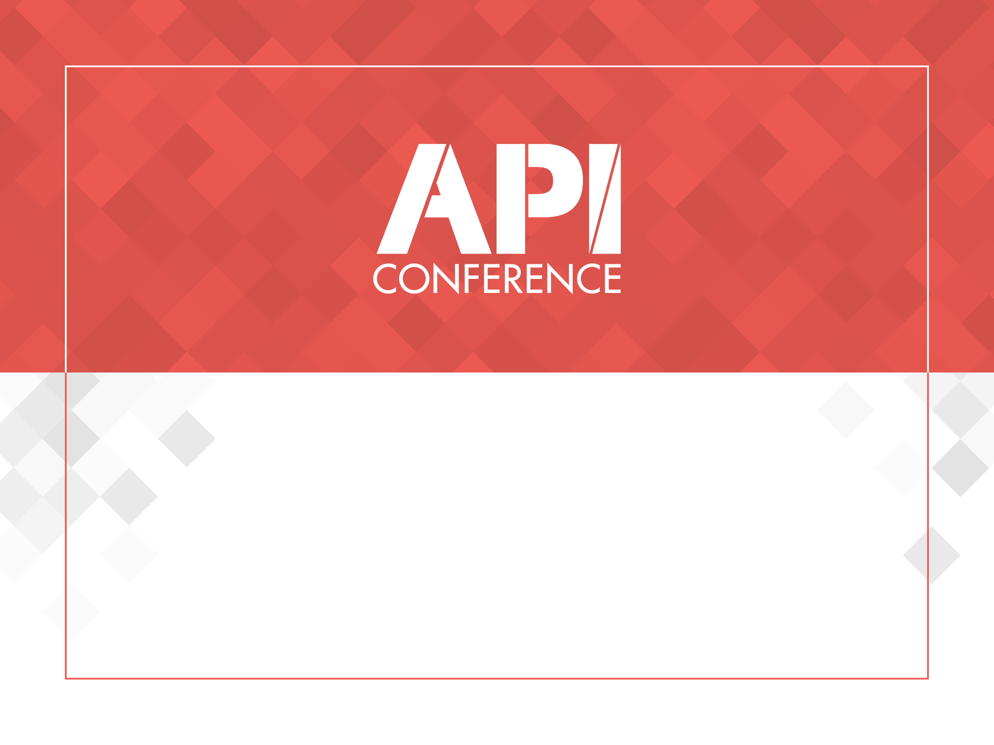
MAKE NODEJS APIs GREAT WITH TYPESCRIPT

Slide 2



ABOUT ME
I really like my work, software engineering never makes me bored, always keeps in learning and improving mood.
dmytro.zharkov@gmail.com
http://bit.ly/2FAm3Lr
http://bit.ly/2FAm3Lr
Notes:
PLATFORM STRATEGY - Connecting People and Fashion
Our aim is to connect people and fashion
We are building the technological infrastructure for online and mobile fashion commerce that enables all participants to create value through our platform
In everything we do, we serve our customers, brands and partners
Investing in tech is one of the key drivers for connecting people and fashion
Development towards a platform
Zalando is building its own infrastructure
Examples:
- Zalando Lounge: a shopping club for price-conscious customers
- Zalon by Zalando: no shop necessary – stylists put together individual outfits, while Zalando enables the contact between customer and stylist and the stylist is choosing from the wide range of the Zalando shop
- Zalando Media Solutions: connecting brands to consumers
To sum up: Zalando Shop is our key business, but there are many more roles that we can play in our customers lives life in order to satisfy their needs regarding fashion

Slide 3

NODEJS REPUTATION
FRONT-END DEVELOPERS
NodeJS
Notes:
ADVANTAGE FOR OUR CUSTOMERS
As we think beyond wholesale and work closely with our brands, we are able to provide a wider and deeper assortment as well as a greater brand variety to our customers
PARTNER PROGRAM
Partner program offers our customers a wider assortment and better availability of products
Connecting brands‘ stock of inventory is part of our platform strategy
Win-win:
Use growth opportunities
Enhance the availability of products - cover size outages
Connect brands to customers
Quality and service standards remain the same
More than 170 partners, biggest partners adidas, Mango, Bestseller Group (e.g. Vero Moda, Only) or Superdry
Currently operating in 11 of the 15 Zalando countries (DE, AT, CH, FR, IT, BE, NL, DK, UK, ES, SE)
BRAND SOLUTIONS
… offers many advantages for our brands; no matter if wholesale or partner program
Through brand solutions, brands can create their own shop within the Zalando shop, similar to a flagship store
We put our brands in the director‘s seat
Who knows better about the latest campaign, product etc.
Brands have great products, great content, great stories. So why not connect them directly to customers? Customers would be able to follow brands they like, live in that brand universe, always get the latest news.
Easy purchase transaction, data analysis, insights into customers’ behaviors
But Brand Solutions are not only Brand Shops, also Content Management System, Analytics and other tools

Slide 4
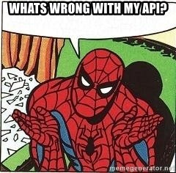
What’s wrong with NodeJS APIs?
Dynamic VS strong typing
Pure OOP model of JS
No of access modifiers
No hypermedia in RESTful APIs
Lack of documentation
Design and structure
Notes:
CONSUMER FOCUS:
In 2016 (financial year): more than 20m active customers placed an average of 3.5 orders directly through our websites and apps.
Our customers’ preferences are as diverse as our portfolio
Various channels help to satisfy those different needs >> from classic online shopper to bargain hunter
Zalando Shop: curated fashion assortment & service focus: free, reliable and quick delivery + return
Zalando Lounge: Daily new sales campaigns with up to 75% discount
Zalon: curated shopping experience – free styling counseling

Slide 5
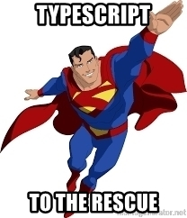
TYPESCRIPT FOR A RESQUE
TYPE SYSTEM
INTERFACES
DECORATORS
ACCESS MODIFIERS
GENERICS
ABSTRACT CLASSES
Notes:
ADVANTAGE FOR OUR CUSTOMERS
As we think beyond wholesale and work closely with our brands, we are able to provide a wider and deeper assortment as well as a greater brand variety to our customers
PARTNER PROGRAM
Partner program offers our customers a wider assortment and better availability of products
Connecting brands‘ stock of inventory is part of our platform strategy
Win-win:
Use growth opportunities
Enhance the availability of products - cover size outages
Connect brands to customers
Quality and service standards remain the same
More than 170 partners, biggest partners adidas, Mango, Bestseller Group (e.g. Vero Moda, Only) or Superdry
Currently operating in 11 of the 15 Zalando countries (DE, AT, CH, FR, IT, BE, NL, DK, UK, ES, SE)
BRAND SOLUTIONS
… offers many advantages for our brands; no matter if wholesale or partner program
Through brand solutions, brands can create their own shop within the Zalando shop, similar to a flagship store
We put our brands in the director‘s seat
Who knows better about the latest campaign, product etc.
Brands have great products, great content, great stories. So why not connect them directly to customers? Customers would be able to follow brands they like, live in that brand universe, always get the latest news.
Easy purchase transaction, data analysis, insights into customers’ behaviors
But Brand Solutions are not only Brand Shops, also Content Management System, Analytics and other tools

Slide 6
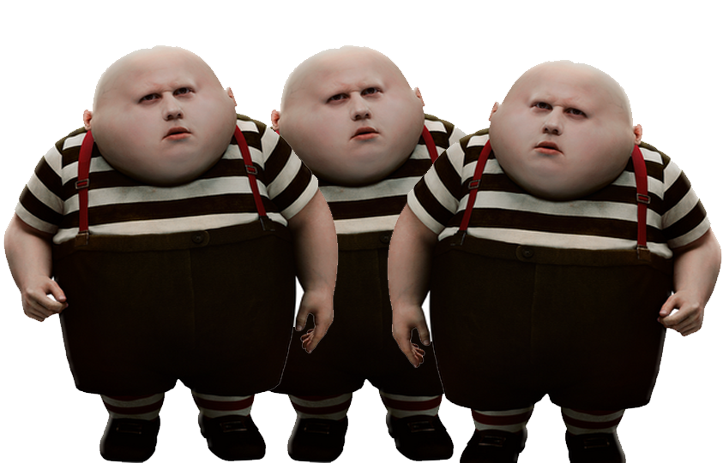
TYPES TRIPLET
TYPE ALIASES
public port: number;
INTERFACES
protected server: http.Server;
CLASSES
public article: Article;
Notes:
ADVANTAGE FOR OUR CUSTOMERS
As we think beyond wholesale and work closely with our brands, we are able to provide a wider and deeper assortment as well as a greater brand variety to our customers
PARTNER PROGRAM
Partner program offers our customers a wider assortment and better availability of products
Connecting brands‘ stock of inventory is part of our platform strategy
Win-win:
Use growth opportunities
Enhance the availability of products - cover size outages
Connect brands to customers
Quality and service standards remain the same
More than 170 partners, biggest partners adidas, Mango, Bestseller Group (e.g. Vero Moda, Only) or Superdry
Currently operating in 11 of the 15 Zalando countries (DE, AT, CH, FR, IT, BE, NL, DK, UK, ES, SE)
BRAND SOLUTIONS
… offers many advantages for our brands; no matter if wholesale or partner program
Through brand solutions, brands can create their own shop within the Zalando shop, similar to a flagship store
We put our brands in the director‘s seat
Who knows better about the latest campaign, product etc.
Brands have great products, great content, great stories. So why not connect them directly to customers? Customers would be able to follow brands they like, live in that brand universe, always get the latest news.
Easy purchase transaction, data analysis, insights into customers’ behaviors
But Brand Solutions are not only Brand Shops, also Content Management System, Analytics and other tools

Slide 7
LET’S COMPARE
TYPE ALISES
Primitive types (number, string, boolean) and reference types (Object).
Can’t be extended
INTERFACES
Reference types only
Can be extended
Signature not implementation
CLASSES
Reference types only
Can be extended
Signature and implementation
Notes:
ADVANTAGE FOR OUR CUSTOMERS
As we think beyond wholesale and work closely with our brands, we are able to provide a wider and deeper assortment as well as a greater brand variety to our customers
PARTNER PROGRAM
Partner program offers our customers a wider assortment and better availability of products
Connecting brands‘ stock of inventory is part of our platform strategy
Win-win:
Use growth opportunities
Enhance the availability of products - cover size outages
Connect brands to customers
Quality and service standards remain the same
More than 170 partners, biggest partners adidas, Mango, Bestseller Group (e.g. Vero Moda, Only) or Superdry
Currently operating in 11 of the 15 Zalando countries (DE, AT, CH, FR, IT, BE, NL, DK, UK, ES, SE)
BRAND SOLUTIONS
… offers many advantages for our brands; no matter if wholesale or partner program
Through brand solutions, brands can create their own shop within the Zalando shop, similar to a flagship store
We put our brands in the director‘s seat
Who knows better about the latest campaign, product etc.
Brands have great products, great content, great stories. So why not connect them directly to customers? Customers would be able to follow brands they like, live in that brand universe, always get the latest news.
Easy purchase transaction, data analysis, insights into customers’ behaviors
But Brand Solutions are not only Brand Shops, also Content Management System, Analytics and other tools

Slide 8
INTERFACES
interface BaseArticle {
SKU: string,
name: string,
type: string,
price: Price
}
export default BaseArticle;
interface FashionArticle extends BaseArticle {
size: Sizes,
color: Colors
}
export default FashionArticle;
import { Document } from "mongoose";
interface FashionArticleModel extends FashionArticle, Document {};
export default FashionArticleModel;
Notes:
ADVANTAGE FOR OUR CUSTOMERS
As we think beyond wholesale and work closely with our brands, we are able to provide a wider and deeper assortment as well as a greater brand variety to our customers
PARTNER PROGRAM
Partner program offers our customers a wider assortment and better availability of products
Connecting brands‘ stock of inventory is part of our platform strategy
Win-win:
Use growth opportunities
Enhance the availability of products - cover size outages
Connect brands to customers
Quality and service standards remain the same
More than 170 partners, biggest partners adidas, Mango, Bestseller Group (e.g. Vero Moda, Only) or Superdry
Currently operating in 11 of the 15 Zalando countries (DE, AT, CH, FR, IT, BE, NL, DK, UK, ES, SE)
BRAND SOLUTIONS
… offers many advantages for our brands; no matter if wholesale or partner program
Through brand solutions, brands can create their own shop within the Zalando shop, similar to a flagship store
We put our brands in the director‘s seat
Who knows better about the latest campaign, product etc.
Brands have great products, great content, great stories. So why not connect them directly to customers? Customers would be able to follow brands they like, live in that brand universe, always get the latest news.
Easy purchase transaction, data analysis, insights into customers’ behaviors
But Brand Solutions are not only Brand Shops, also Content Management System, Analytics and other tools

Slide 9
USING INTERFACES AND GENERICS
import { Schema, Model, model} from "mongoose";
import FashionArticleModel from "../interfaces/FashionArticleModel";
const ArticleSchema: Schema = new Schema({
….
});
const ArticleModel: Model<FashionArticleModel> = model<FashionArticleModel>("Article", ArticleSchema);
export {ArticleModel};
Notes:
ADVANTAGE FOR OUR CUSTOMERS
As we think beyond wholesale and work closely with our brands, we are able to provide a wider and deeper assortment as well as a greater brand variety to our customers
PARTNER PROGRAM
Partner program offers our customers a wider assortment and better availability of products
Connecting brands‘ stock of inventory is part of our platform strategy
Win-win:
Use growth opportunities
Enhance the availability of products - cover size outages
Connect brands to customers
Quality and service standards remain the same
More than 170 partners, biggest partners adidas, Mango, Bestseller Group (e.g. Vero Moda, Only) or Superdry
Currently operating in 11 of the 15 Zalando countries (DE, AT, CH, FR, IT, BE, NL, DK, UK, ES, SE)
BRAND SOLUTIONS
… offers many advantages for our brands; no matter if wholesale or partner program
Through brand solutions, brands can create their own shop within the Zalando shop, similar to a flagship store
We put our brands in the director‘s seat
Who knows better about the latest campaign, product etc.
Brands have great products, great content, great stories. So why not connect them directly to customers? Customers would be able to follow brands they like, live in that brand universe, always get the latest news.
Easy purchase transaction, data analysis, insights into customers’ behaviors
But Brand Solutions are not only Brand Shops, also Content Management System, Analytics and other tools

Slide 10
MORE INTERFACES
export class Server {
protected app: express.Application;
protected server: http.Server;
private db: mongoose.Connection;
private routes: express.Router[] = [];
}
Notes:
ADVANTAGE FOR OUR CUSTOMERS
As we think beyond wholesale and work closely with our brands, we are able to provide a wider and deeper assortment as well as a greater brand variety to our customers
PARTNER PROGRAM
Partner program offers our customers a wider assortment and better availability of products
Connecting brands‘ stock of inventory is part of our platform strategy
Win-win:
Use growth opportunities
Enhance the availability of products - cover size outages
Connect brands to customers
Quality and service standards remain the same
More than 170 partners, biggest partners adidas, Mango, Bestseller Group (e.g. Vero Moda, Only) or Superdry
Currently operating in 11 of the 15 Zalando countries (DE, AT, CH, FR, IT, BE, NL, DK, UK, ES, SE)
BRAND SOLUTIONS
… offers many advantages for our brands; no matter if wholesale or partner program
Through brand solutions, brands can create their own shop within the Zalando shop, similar to a flagship store
We put our brands in the director‘s seat
Who knows better about the latest campaign, product etc.
Brands have great products, great content, great stories. So why not connect them directly to customers? Customers would be able to follow brands they like, live in that brand universe, always get the latest news.
Easy purchase transaction, data analysis, insights into customers’ behaviors
But Brand Solutions are not only Brand Shops, also Content Management System, Analytics and other tools

Slide 11

ACCESS MODIFIERS
PUBLIC
Default modifier and can be omitted (better not).
PRIVATE
Restics members visibility to current class only.
PROTECTED
Visible in derived classes.
Notes:
ADVANTAGE FOR OUR CUSTOMERS
As we think beyond wholesale and work closely with our brands, we are able to provide a wider and deeper assortment as well as a greater brand variety to our customers
PARTNER PROGRAM
Partner program offers our customers a wider assortment and better availability of products
Connecting brands‘ stock of inventory is part of our platform strategy
Win-win:
Use growth opportunities
Enhance the availability of products - cover size outages
Connect brands to customers
Quality and service standards remain the same
More than 170 partners, biggest partners adidas, Mango, Bestseller Group (e.g. Vero Moda, Only) or Superdry
Currently operating in 11 of the 15 Zalando countries (DE, AT, CH, FR, IT, BE, NL, DK, UK, ES, SE)
BRAND SOLUTIONS
… offers many advantages for our brands; no matter if wholesale or partner program
Through brand solutions, brands can create their own shop within the Zalando shop, similar to a flagship store
We put our brands in the director‘s seat
Who knows better about the latest campaign, product etc.
Brands have great products, great content, great stories. So why not connect them directly to customers? Customers would be able to follow brands they like, live in that brand universe, always get the latest news.
Easy purchase transaction, data analysis, insights into customers’ behaviors
But Brand Solutions are not only Brand Shops, also Content Management System, Analytics and other tools

Slide 12
IN PRACTICE
class Server {
protected app: express.Application;
protected server: http.Server;
public port: number;
constructor(port: number = 3000) {
this.app = express();
this.port = port;
this.app.set("port", port);
this.app.listen(this.port);
}
}
import * as io from "socket.io";
class SocketServer extends Server {
private socketServer: io.Server;
constructor(public port: number) {
super(port);
this.socketServer = io(this.server);
….
}
}
Notes:
ADVANTAGE FOR OUR CUSTOMERS
As we think beyond wholesale and work closely with our brands, we are able to provide a wider and deeper assortment as well as a greater brand variety to our customers
PARTNER PROGRAM
Partner program offers our customers a wider assortment and better availability of products
Connecting brands‘ stock of inventory is part of our platform strategy
Win-win:
Use growth opportunities
Enhance the availability of products - cover size outages
Connect brands to customers
Quality and service standards remain the same
More than 170 partners, biggest partners adidas, Mango, Bestseller Group (e.g. Vero Moda, Only) or Superdry
Currently operating in 11 of the 15 Zalando countries (DE, AT, CH, FR, IT, BE, NL, DK, UK, ES, SE)
BRAND SOLUTIONS
… offers many advantages for our brands; no matter if wholesale or partner program
Through brand solutions, brands can create their own shop within the Zalando shop, similar to a flagship store
We put our brands in the director‘s seat
Who knows better about the latest campaign, product etc.
Brands have great products, great content, great stories. So why not connect them directly to customers? Customers would be able to follow brands they like, live in that brand universe, always get the latest news.
Easy purchase transaction, data analysis, insights into customers’ behaviors
But Brand Solutions are not only Brand Shops, also Content Management System, Analytics and other tools

Slide 13
DECORATORS
CLASSES
METHODS
PARAMETERS
FIELDS
Notes:
ADVANTAGE FOR OUR CUSTOMERS
As we think beyond wholesale and work closely with our brands, we are able to provide a wider and deeper assortment as well as a greater brand variety to our customers
PARTNER PROGRAM
Partner program offers our customers a wider assortment and better availability of products
Connecting brands‘ stock of inventory is part of our platform strategy
Win-win:
Use growth opportunities
Enhance the availability of products - cover size outages
Connect brands to customers
Quality and service standards remain the same
More than 170 partners, biggest partners adidas, Mango, Bestseller Group (e.g. Vero Moda, Only) or Superdry
Currently operating in 11 of the 15 Zalando countries (DE, AT, CH, FR, IT, BE, NL, DK, UK, ES, SE)
BRAND SOLUTIONS
… offers many advantages for our brands; no matter if wholesale or partner program
Through brand solutions, brands can create their own shop within the Zalando shop, similar to a flagship store
We put our brands in the director‘s seat
Who knows better about the latest campaign, product etc.
Brands have great products, great content, great stories. So why not connect them directly to customers? Customers would be able to follow brands they like, live in that brand universe, always get the latest news.
Easy purchase transaction, data analysis, insights into customers’ behaviors
But Brand Solutions are not only Brand Shops, also Content Management System, Analytics and other tools

Slide 14
EXAMPLE: TRY-CATCH WRAPPER
class TestClass {
public doSomething(str: string): boolean {
return str.length > 0;
}
}
var safeTest: TestClass = new TestClass();
safeTest.doSomething(null);
safeTest.doSomething("Hello from IJS and API conference");
@safe
Notes:
ADVANTAGE FOR OUR CUSTOMERS
As we think beyond wholesale and work closely with our brands, we are able to provide a wider and deeper assortment as well as a greater brand variety to our customers
PARTNER PROGRAM
Partner program offers our customers a wider assortment and better availability of products
Connecting brands‘ stock of inventory is part of our platform strategy
Win-win:
Use growth opportunities
Enhance the availability of products - cover size outages
Connect brands to customers
Quality and service standards remain the same
More than 170 partners, biggest partners adidas, Mango, Bestseller Group (e.g. Vero Moda, Only) or Superdry
Currently operating in 11 of the 15 Zalando countries (DE, AT, CH, FR, IT, BE, NL, DK, UK, ES, SE)
BRAND SOLUTIONS
… offers many advantages for our brands; no matter if wholesale or partner program
Through brand solutions, brands can create their own shop within the Zalando shop, similar to a flagship store
We put our brands in the director‘s seat
Who knows better about the latest campaign, product etc.
Brands have great products, great content, great stories. So why not connect them directly to customers? Customers would be able to follow brands they like, live in that brand universe, always get the latest news.
Easy purchase transaction, data analysis, insights into customers’ behaviors
But Brand Solutions are not only Brand Shops, also Content Management System, Analytics and other tools

Slide 15
EXAMPLE: TRY-CATCH WRAPPER
function safe(target: any, propertyKey: string, descriptor: TypedPropertyDescriptor<any>): TypedPropertyDescriptor<any> {
let originalMethod = descriptor.value;
descriptor.value = function () {
try {
originalMethod.apply(this, arguments);
} catch(ex) {
console.error(ex);
}
};
return descriptor;
}
Notes:
ADVANTAGE FOR OUR CUSTOMERS
As we think beyond wholesale and work closely with our brands, we are able to provide a wider and deeper assortment as well as a greater brand variety to our customers
PARTNER PROGRAM
Partner program offers our customers a wider assortment and better availability of products
Connecting brands‘ stock of inventory is part of our platform strategy
Win-win:
Use growth opportunities
Enhance the availability of products - cover size outages
Connect brands to customers
Quality and service standards remain the same
More than 170 partners, biggest partners adidas, Mango, Bestseller Group (e.g. Vero Moda, Only) or Superdry
Currently operating in 11 of the 15 Zalando countries (DE, AT, CH, FR, IT, BE, NL, DK, UK, ES, SE)
BRAND SOLUTIONS
… offers many advantages for our brands; no matter if wholesale or partner program
Through brand solutions, brands can create their own shop within the Zalando shop, similar to a flagship store
We put our brands in the director‘s seat
Who knows better about the latest campaign, product etc.
Brands have great products, great content, great stories. So why not connect them directly to customers? Customers would be able to follow brands they like, live in that brand universe, always get the latest news.
Easy purchase transaction, data analysis, insights into customers’ behaviors
But Brand Solutions are not only Brand Shops, also Content Management System, Analytics and other tools

Slide 16
EXAMPLE: DECLARATIVE ROUTES
Typical ExpressJS route:
var express = require('express');
var router = express.Router();
router.get('/', function(req, res, next) {
res.send('respond with a resource');
});
router.get('/:id', function(req, res, next) {
res.send('respond with a resource');
});
Notes:
ADVANTAGE FOR OUR CUSTOMERS
As we think beyond wholesale and work closely with our brands, we are able to provide a wider and deeper assortment as well as a greater brand variety to our customers
PARTNER PROGRAM
Partner program offers our customers a wider assortment and better availability of products
Connecting brands‘ stock of inventory is part of our platform strategy
Win-win:
Use growth opportunities
Enhance the availability of products - cover size outages
Connect brands to customers
Quality and service standards remain the same
More than 170 partners, biggest partners adidas, Mango, Bestseller Group (e.g. Vero Moda, Only) or Superdry
Currently operating in 11 of the 15 Zalando countries (DE, AT, CH, FR, IT, BE, NL, DK, UK, ES, SE)
BRAND SOLUTIONS
… offers many advantages for our brands; no matter if wholesale or partner program
Through brand solutions, brands can create their own shop within the Zalando shop, similar to a flagship store
We put our brands in the director‘s seat
Who knows better about the latest campaign, product etc.
Brands have great products, great content, great stories. So why not connect them directly to customers? Customers would be able to follow brands they like, live in that brand universe, always get the latest news.
Easy purchase transaction, data analysis, insights into customers’ behaviors
But Brand Solutions are not only Brand Shops, also Content Management System, Analytics and other tools

Slide 17
EXAMPLE: DECLARATIVE ROUTES
@RouteHandler("/sample-route")
class SampleRoute {
public router: Router;
constructor(public app: Server) {}
@Get()
public resources(req: Request, res: Response) {
res.json([]);
}
@Get("/:id")
public resources(req: Request, res: Response) {
res.json({});
}
}
Notes:
ADVANTAGE FOR OUR CUSTOMERS
As we think beyond wholesale and work closely with our brands, we are able to provide a wider and deeper assortment as well as a greater brand variety to our customers
PARTNER PROGRAM
Partner program offers our customers a wider assortment and better availability of products
Connecting brands‘ stock of inventory is part of our platform strategy
Win-win:
Use growth opportunities
Enhance the availability of products - cover size outages
Connect brands to customers
Quality and service standards remain the same
More than 170 partners, biggest partners adidas, Mango, Bestseller Group (e.g. Vero Moda, Only) or Superdry
Currently operating in 11 of the 15 Zalando countries (DE, AT, CH, FR, IT, BE, NL, DK, UK, ES, SE)
BRAND SOLUTIONS
… offers many advantages for our brands; no matter if wholesale or partner program
Through brand solutions, brands can create their own shop within the Zalando shop, similar to a flagship store
We put our brands in the director‘s seat
Who knows better about the latest campaign, product etc.
Brands have great products, great content, great stories. So why not connect them directly to customers? Customers would be able to follow brands they like, live in that brand universe, always get the latest news.
Easy purchase transaction, data analysis, insights into customers’ behaviors
But Brand Solutions are not only Brand Shops, also Content Management System, Analytics and other tools

Slide 18
EXAMPLE: REQUEST VALIDATION
@Validate({
param: "name",
validate: "required"
})
public createArticle(request: Request, response: Response): void {
// create an article
}
Notes:
ADVANTAGE FOR OUR CUSTOMERS
As we think beyond wholesale and work closely with our brands, we are able to provide a wider and deeper assortment as well as a greater brand variety to our customers
PARTNER PROGRAM
Partner program offers our customers a wider assortment and better availability of products
Connecting brands‘ stock of inventory is part of our platform strategy
Win-win:
Use growth opportunities
Enhance the availability of products - cover size outages
Connect brands to customers
Quality and service standards remain the same
More than 170 partners, biggest partners adidas, Mango, Bestseller Group (e.g. Vero Moda, Only) or Superdry
Currently operating in 11 of the 15 Zalando countries (DE, AT, CH, FR, IT, BE, NL, DK, UK, ES, SE)
BRAND SOLUTIONS
… offers many advantages for our brands; no matter if wholesale or partner program
Through brand solutions, brands can create their own shop within the Zalando shop, similar to a flagship store
We put our brands in the director‘s seat
Who knows better about the latest campaign, product etc.
Brands have great products, great content, great stories. So why not connect them directly to customers? Customers would be able to follow brands they like, live in that brand universe, always get the latest news.
Easy purchase transaction, data analysis, insights into customers’ behaviors
But Brand Solutions are not only Brand Shops, also Content Management System, Analytics and other tools

Slide 19
EXAMPLE: REQUEST VALIDATION
export function Validate(params: Array<any>): any {
return (target: Object, propertyKey: string): TypedPropertyDescriptor<any> => {
const descriptor = Object.getOwnPropertyDescriptor(target, propertyKey);
const originalMethod = descriptor.value;
descriptor.value = function () {
const body = arguments[0].body;
const response = arguments[1];
// do some work
};
return descriptor;
};
}
Notes:
ADVANTAGE FOR OUR CUSTOMERS
As we think beyond wholesale and work closely with our brands, we are able to provide a wider and deeper assortment as well as a greater brand variety to our customers
PARTNER PROGRAM
Partner program offers our customers a wider assortment and better availability of products
Connecting brands‘ stock of inventory is part of our platform strategy
Win-win:
Use growth opportunities
Enhance the availability of products - cover size outages
Connect brands to customers
Quality and service standards remain the same
More than 170 partners, biggest partners adidas, Mango, Bestseller Group (e.g. Vero Moda, Only) or Superdry
Currently operating in 11 of the 15 Zalando countries (DE, AT, CH, FR, IT, BE, NL, DK, UK, ES, SE)
BRAND SOLUTIONS
… offers many advantages for our brands; no matter if wholesale or partner program
Through brand solutions, brands can create their own shop within the Zalando shop, similar to a flagship store
We put our brands in the director‘s seat
Who knows better about the latest campaign, product etc.
Brands have great products, great content, great stories. So why not connect them directly to customers? Customers would be able to follow brands they like, live in that brand universe, always get the latest news.
Easy purchase transaction, data analysis, insights into customers’ behaviors
But Brand Solutions are not only Brand Shops, also Content Management System, Analytics and other tools

Slide 20
EXAMPLE: HATEOAS
Hypermedia allows to decouple client and server to a large extent and allow them to evolve independently.
Notes:
ADVANTAGE FOR OUR CUSTOMERS
As we think beyond wholesale and work closely with our brands, we are able to provide a wider and deeper assortment as well as a greater brand variety to our customers
PARTNER PROGRAM
Partner program offers our customers a wider assortment and better availability of products
Connecting brands‘ stock of inventory is part of our platform strategy
Win-win:
Use growth opportunities
Enhance the availability of products - cover size outages
Connect brands to customers
Quality and service standards remain the same
More than 170 partners, biggest partners adidas, Mango, Bestseller Group (e.g. Vero Moda, Only) or Superdry
Currently operating in 11 of the 15 Zalando countries (DE, AT, CH, FR, IT, BE, NL, DK, UK, ES, SE)
BRAND SOLUTIONS
… offers many advantages for our brands; no matter if wholesale or partner program
Through brand solutions, brands can create their own shop within the Zalando shop, similar to a flagship store
We put our brands in the director‘s seat
Who knows better about the latest campaign, product etc.
Brands have great products, great content, great stories. So why not connect them directly to customers? Customers would be able to follow brands they like, live in that brand universe, always get the latest news.
Easy purchase transaction, data analysis, insights into customers’ behaviors
But Brand Solutions are not only Brand Shops, also Content Management System, Analytics and other tools

Slide 21
EXAMPLE: HYPERMEDIA
DEMO
Notes:
ADVANTAGE FOR OUR CUSTOMERS
As we think beyond wholesale and work closely with our brands, we are able to provide a wider and deeper assortment as well as a greater brand variety to our customers
PARTNER PROGRAM
Partner program offers our customers a wider assortment and better availability of products
Connecting brands‘ stock of inventory is part of our platform strategy
Win-win:
Use growth opportunities
Enhance the availability of products - cover size outages
Connect brands to customers
Quality and service standards remain the same
More than 170 partners, biggest partners adidas, Mango, Bestseller Group (e.g. Vero Moda, Only) or Superdry
Currently operating in 11 of the 15 Zalando countries (DE, AT, CH, FR, IT, BE, NL, DK, UK, ES, SE)
BRAND SOLUTIONS
… offers many advantages for our brands; no matter if wholesale or partner program
Through brand solutions, brands can create their own shop within the Zalando shop, similar to a flagship store
We put our brands in the director‘s seat
Who knows better about the latest campaign, product etc.
Brands have great products, great content, great stories. So why not connect them directly to customers? Customers would be able to follow brands they like, live in that brand universe, always get the latest news.
Easy purchase transaction, data analysis, insights into customers’ behaviors
But Brand Solutions are not only Brand Shops, also Content Management System, Analytics and other tools

Slide 22

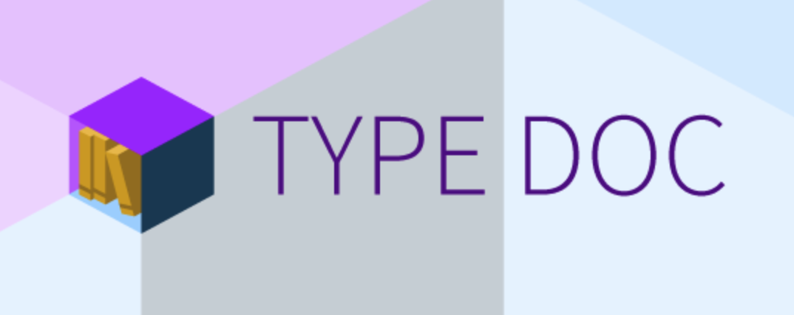
DOCUMENTATION
TSOA
Notes:
ADVANTAGE FOR OUR CUSTOMERS
As we think beyond wholesale and work closely with our brands, we are able to provide a wider and deeper assortment as well as a greater brand variety to our customers
PARTNER PROGRAM
Partner program offers our customers a wider assortment and better availability of products
Connecting brands‘ stock of inventory is part of our platform strategy
Win-win:
Use growth opportunities
Enhance the availability of products - cover size outages
Connect brands to customers
Quality and service standards remain the same
More than 170 partners, biggest partners adidas, Mango, Bestseller Group (e.g. Vero Moda, Only) or Superdry
Currently operating in 11 of the 15 Zalando countries (DE, AT, CH, FR, IT, BE, NL, DK, UK, ES, SE)
BRAND SOLUTIONS
… offers many advantages for our brands; no matter if wholesale or partner program
Through brand solutions, brands can create their own shop within the Zalando shop, similar to a flagship store
We put our brands in the director‘s seat
Who knows better about the latest campaign, product etc.
Brands have great products, great content, great stories. So why not connect them directly to customers? Customers would be able to follow brands they like, live in that brand universe, always get the latest news.
Easy purchase transaction, data analysis, insights into customers’ behaviors
But Brand Solutions are not only Brand Shops, also Content Management System, Analytics and other tools

Slide 23
AUTO SWAGGER DOCUMENTATION WITH DECORATORS
TSOA
@Route("Users")
class ArticlesService {
@Post()
public createArticle(@Body() requestBody: FashionArticle): Promise<FashionArticle> {
// create an article
}
}
export default ArticlesService;
Notes:
ADVANTAGE FOR OUR CUSTOMERS
As we think beyond wholesale and work closely with our brands, we are able to provide a wider and deeper assortment as well as a greater brand variety to our customers
PARTNER PROGRAM
Partner program offers our customers a wider assortment and better availability of products
Connecting brands‘ stock of inventory is part of our platform strategy
Win-win:
Use growth opportunities
Enhance the availability of products - cover size outages
Connect brands to customers
Quality and service standards remain the same
More than 170 partners, biggest partners adidas, Mango, Bestseller Group (e.g. Vero Moda, Only) or Superdry
Currently operating in 11 of the 15 Zalando countries (DE, AT, CH, FR, IT, BE, NL, DK, UK, ES, SE)
BRAND SOLUTIONS
… offers many advantages for our brands; no matter if wholesale or partner program
Through brand solutions, brands can create their own shop within the Zalando shop, similar to a flagship store
We put our brands in the director‘s seat
Who knows better about the latest campaign, product etc.
Brands have great products, great content, great stories. So why not connect them directly to customers? Customers would be able to follow brands they like, live in that brand universe, always get the latest news.
Easy purchase transaction, data analysis, insights into customers’ behaviors
But Brand Solutions are not only Brand Shops, also Content Management System, Analytics and other tools

Slide 24
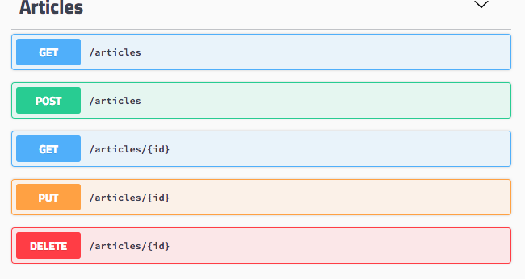
AUTO SWAGGER DOCS WITH DECORATORS
Notes:
ADVANTAGE FOR OUR CUSTOMERS
As we think beyond wholesale and work closely with our brands, we are able to provide a wider and deeper assortment as well as a greater brand variety to our customers
PARTNER PROGRAM
Partner program offers our customers a wider assortment and better availability of products
Connecting brands‘ stock of inventory is part of our platform strategy
Win-win:
Use growth opportunities
Enhance the availability of products - cover size outages
Connect brands to customers
Quality and service standards remain the same
More than 170 partners, biggest partners adidas, Mango, Bestseller Group (e.g. Vero Moda, Only) or Superdry
Currently operating in 11 of the 15 Zalando countries (DE, AT, CH, FR, IT, BE, NL, DK, UK, ES, SE)
BRAND SOLUTIONS
… offers many advantages for our brands; no matter if wholesale or partner program
Through brand solutions, brands can create their own shop within the Zalando shop, similar to a flagship store
We put our brands in the director‘s seat
Who knows better about the latest campaign, product etc.
Brands have great products, great content, great stories. So why not connect them directly to customers? Customers would be able to follow brands they like, live in that brand universe, always get the latest news.
Easy purchase transaction, data analysis, insights into customers’ behaviors
But Brand Solutions are not only Brand Shops, also Content Management System, Analytics and other tools

Slide 25
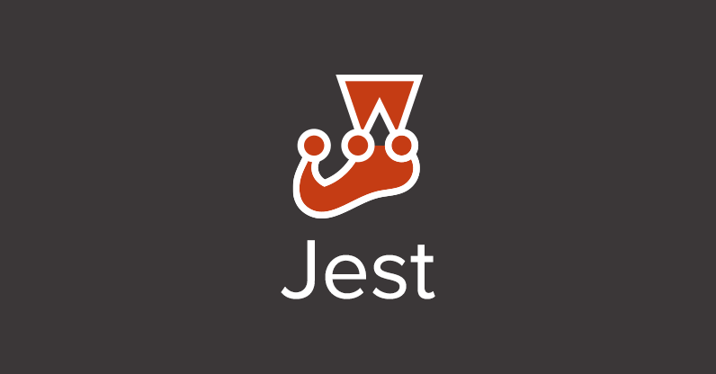
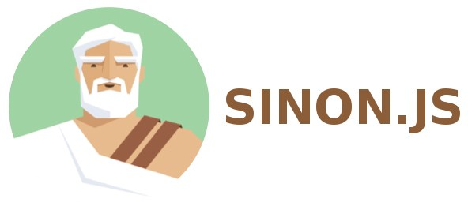
UNIT AND INTEGRATION TESTS
WRITE YOUR TESTS IN TYPESCRIPT
SUPERTEST
Notes:
ADVANTAGE FOR OUR CUSTOMERS
As we think beyond wholesale and work closely with our brands, we are able to provide a wider and deeper assortment as well as a greater brand variety to our customers
PARTNER PROGRAM
Partner program offers our customers a wider assortment and better availability of products
Connecting brands‘ stock of inventory is part of our platform strategy
Win-win:
Use growth opportunities
Enhance the availability of products - cover size outages
Connect brands to customers
Quality and service standards remain the same
More than 170 partners, biggest partners adidas, Mango, Bestseller Group (e.g. Vero Moda, Only) or Superdry
Currently operating in 11 of the 15 Zalando countries (DE, AT, CH, FR, IT, BE, NL, DK, UK, ES, SE)
BRAND SOLUTIONS
… offers many advantages for our brands; no matter if wholesale or partner program
Through brand solutions, brands can create their own shop within the Zalando shop, similar to a flagship store
We put our brands in the director‘s seat
Who knows better about the latest campaign, product etc.
Brands have great products, great content, great stories. So why not connect them directly to customers? Customers would be able to follow brands they like, live in that brand universe, always get the latest news.
Easy purchase transaction, data analysis, insights into customers’ behaviors
But Brand Solutions are not only Brand Shops, also Content Management System, Analytics and other tools

Slide 26
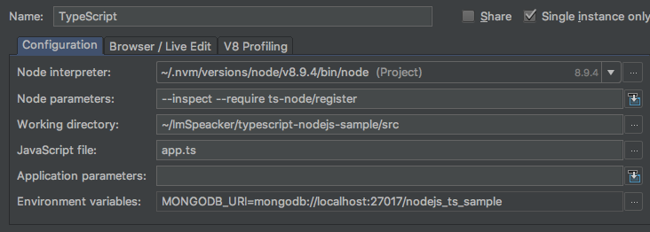
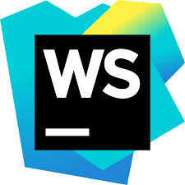
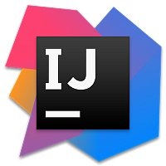
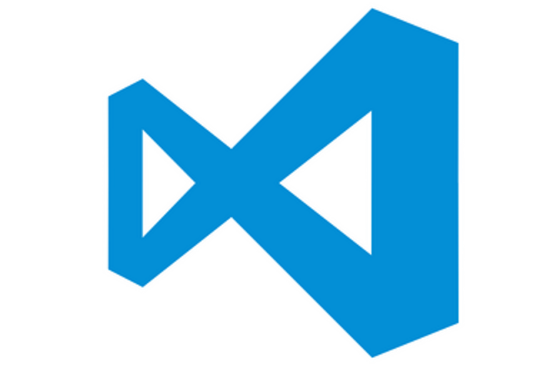
DEBUG DIRECTLY IN TS
Notes:
ADVANTAGE FOR OUR CUSTOMERS
As we think beyond wholesale and work closely with our brands, we are able to provide a wider and deeper assortment as well as a greater brand variety to our customers
PARTNER PROGRAM
Partner program offers our customers a wider assortment and better availability of products
Connecting brands‘ stock of inventory is part of our platform strategy
Win-win:
Use growth opportunities
Enhance the availability of products - cover size outages
Connect brands to customers
Quality and service standards remain the same
More than 170 partners, biggest partners adidas, Mango, Bestseller Group (e.g. Vero Moda, Only) or Superdry
Currently operating in 11 of the 15 Zalando countries (DE, AT, CH, FR, IT, BE, NL, DK, UK, ES, SE)
BRAND SOLUTIONS
… offers many advantages for our brands; no matter if wholesale or partner program
Through brand solutions, brands can create their own shop within the Zalando shop, similar to a flagship store
We put our brands in the director‘s seat
Who knows better about the latest campaign, product etc.
Brands have great products, great content, great stories. So why not connect them directly to customers? Customers would be able to follow brands they like, live in that brand universe, always get the latest news.
Easy purchase transaction, data analysis, insights into customers’ behaviors
But Brand Solutions are not only Brand Shops, also Content Management System, Analytics and other tools

Slide 27

DRAWBACKS
Additional build step.
Lack of definition files for npm modules.
Source and compiled code.
Notes:
ADVANTAGE FOR OUR CUSTOMERS
As we think beyond wholesale and work closely with our brands, we are able to provide a wider and deeper assortment as well as a greater brand variety to our customers
PARTNER PROGRAM
Partner program offers our customers a wider assortment and better availability of products
Connecting brands‘ stock of inventory is part of our platform strategy
Win-win:
Use growth opportunities
Enhance the availability of products - cover size outages
Connect brands to customers
Quality and service standards remain the same
More than 170 partners, biggest partners adidas, Mango, Bestseller Group (e.g. Vero Moda, Only) or Superdry
Currently operating in 11 of the 15 Zalando countries (DE, AT, CH, FR, IT, BE, NL, DK, UK, ES, SE)
BRAND SOLUTIONS
… offers many advantages for our brands; no matter if wholesale or partner program
Through brand solutions, brands can create their own shop within the Zalando shop, similar to a flagship store
We put our brands in the director‘s seat
Who knows better about the latest campaign, product etc.
Brands have great products, great content, great stories. So why not connect them directly to customers? Customers would be able to follow brands they like, live in that brand universe, always get the latest news.
Easy purchase transaction, data analysis, insights into customers’ behaviors
But Brand Solutions are not only Brand Shops, also Content Management System, Analytics and other tools

Slide 28
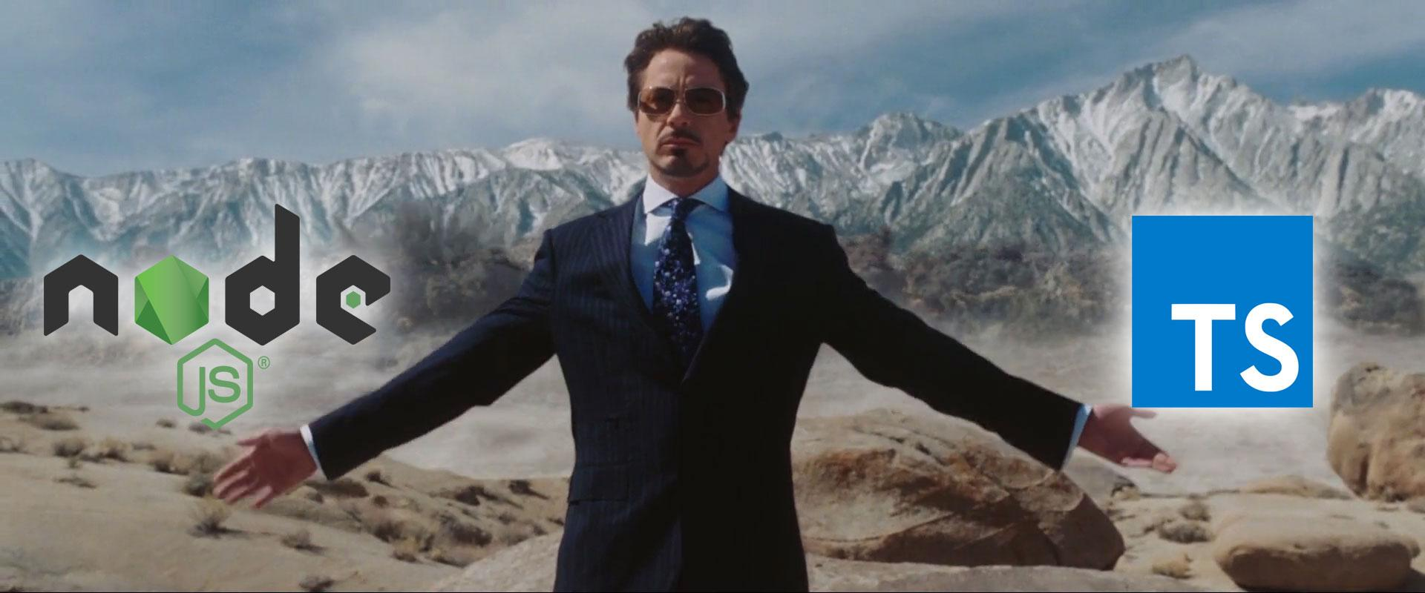
MAKE NODEJS APIs GREAT WITH TYPESCRIPT

Slide 29
THANKS FOR ATTENTION
Slides
NodeJS TypeScript starter http://bit.ly/2FW64qn
TSOA auto swagger documentation http://bit.ly/2FW64qn
Notes:
ADVANTAGE FOR OUR CUSTOMERS
As we think beyond wholesale and work closely with our brands, we are able to provide a wider and deeper assortment as well as a greater brand variety to our customers
PARTNER PROGRAM
Partner program offers our customers a wider assortment and better availability of products
Connecting brands‘ stock of inventory is part of our platform strategy
Win-win:
Use growth opportunities
Enhance the availability of products - cover size outages
Connect brands to customers
Quality and service standards remain the same
More than 170 partners, biggest partners adidas, Mango, Bestseller Group (e.g. Vero Moda, Only) or Superdry
Currently operating in 11 of the 15 Zalando countries (DE, AT, CH, FR, IT, BE, NL, DK, UK, ES, SE)
BRAND SOLUTIONS
… offers many advantages for our brands; no matter if wholesale or partner program
Through brand solutions, brands can create their own shop within the Zalando shop, similar to a flagship store
We put our brands in the director‘s seat
Who knows better about the latest campaign, product etc.
Brands have great products, great content, great stories. So why not connect them directly to customers? Customers would be able to follow brands they like, live in that brand universe, always get the latest news.
Easy purchase transaction, data analysis, insights into customers’ behaviors
But Brand Solutions are not only Brand Shops, also Content Management System, Analytics and other tools

